Slide 1
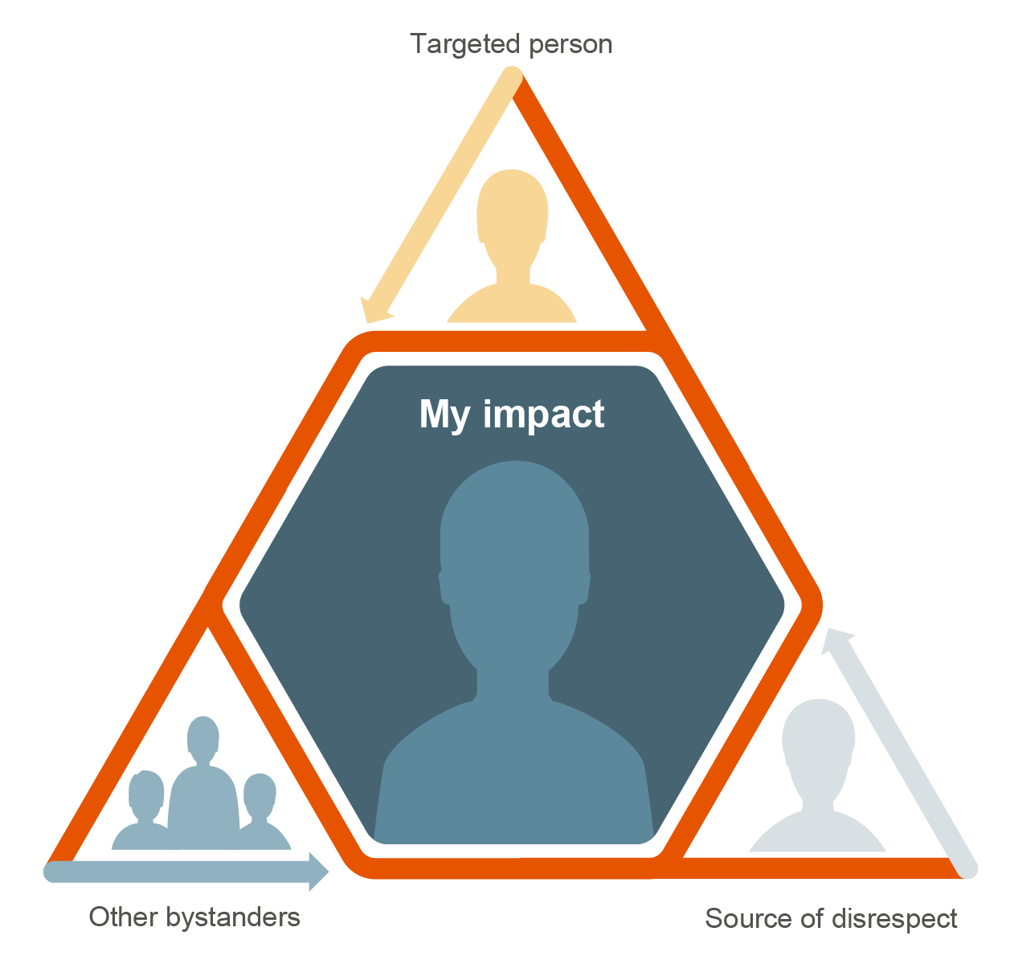
Active Bystander Training
What is in this pack
How to use this pack
Four trainings (10 minute each):
❶ What stops us from intervening?
❷ Impact of our responses on others
❸ How to be effective bystanders- giving feedback
❹ How to be effective bystanders- safe to speak up
Deliver each of the four trainings

Slide 2
Active Bystanders
Training
❶
What stops us from intervening

Slide 3
Using this training
Intent of this training
The intent is to get your team thinking about different ways of responding to both physical and non-physical harm, through the lens of being the bystander.
How the session will run
The training will run for 10 minutes.
Your team will be given prompting questions to start the conversation. Generate discussion around where certain behaviours might sit in the above and below the line graphic. Encourage your team to debate the topic.
What’s in the session
This session uses images and visual prompts that have open ended questions to discuss with your team.
The session has reflective questions at the end for your team to reflect on after the training.

Slide 4
What is the first thing we do when we see smoke, that’s potentially a fire and identify that is an immediate risk to our physical safety.
Thought starter
So, we know exactly what to do when our
physical safety is at risk.
What about when the risk isn’t physical (e.g. name calling)?
Would what you do if you witnessed this?
Notes:
Photo by Paul Bulai on Unsplash

Slide 5
How are we interacting with one another?
Giving someone a nickname
Saying straight after a sexist comment: ‘I’m just joking, you know that right?’
Knowing what you said about your teammates appearance was disrespectful and thinking ‘I wanted to apologise for my behaviour and didn’t get around to it’

Slide 6
Personal Reflection Takeaway
When we witness disrespectful behaviour as a bystander, what stops us from saying or doing something? What do you think the difference is?

Slide 7
Need further support
Contract Owner, Contract Owner Representative or Job Initiator
Please reach out to a trusted person in your network
Your Leader
Your 2-Up Leader
EthicsPoint anonymously 24/7
Human Resources
Someone you trust
EAP
Notes:
Timing: 1-2 min
LEARNING OBJECTIVE
Know where to find support tools and resources
FACILITATOR NOTES:
SAY: You are not in this alone - If you don’t feel comfortable in speaking up or require further support, speak to a trusted person. You are never alone – we are always here to help.
For support you can contact your local Employee Assistance Program (EAP). The EAP can also provide advice on how to provide feedback to someone relating to below the line behaviours or manage a difficult situation.
Ethics Point is available to all BHP employees, contractors, customers, suppliers or stakeholders.
This service can be used to report a concern or to ask a question about Our Code or Our Charter Values in action.
You can submit a report online via the Digital Workspace or over the telephone at any time.
The information you provide will always be dealt with confidentially and respectfully. If you wish to remain anonymous, all reasonable steps will be taken to protect your identity.

Slide 9
Active Bystanders
Training
❷
Impact of our responses on others

Slide 10
Using this training
1. Intent of this training
We want to start a conversation around how situations may affect and impact others.
3. What’s in the session
You will play a video scenario based on a real life incident that occurred at BHP. The group will be given open ended questions to discuss as a team. The session will finish with a team call to action.
2. How the session will run
The training will run for 10 mins.
Your team will be given prompting questions to start the conversation.
You will have conversation starters in the notes section of the slide.

Slide 11
Play video
Notes:
Play the video to open the training talk.
If you are offline, read the script below to the group:
It happened to me
I worked with a small team on site, all male, so it was a pretty macho environment
Everyone live in town and we all knew each others partners and kids.
A new bloke joined the crew. He’d come from another company and he seemed nice enough. He set up a WhatsApp group and we started using it to talk about footy, the best fishing spots, all harmless. But the he started sending some pretty dirty sexual stuff. Some of the others were really into it, but I felt uncomfortable and I knew of the others did too.
It got pretty bad, so one day I took him aside and suggested he stop. He laughed at me, he told me to man up and then he said he’d tell my wife that I was into it if I reported him. I didn’t want to cause a drama over it so I just let it go. Eventually that same guy lost his job because he assaulted someone at a work party. I felt guilty then, I wish I’d spoken up so he might have been stopped before someone got hurt.

Slide 12
When we do nothing, what message do we send to the
source of disrespect, the targeted person and other bystanders?
What are the short and long-term effects of doing nothing?
Your impact
What could we do as a team?
What are some ways we could take action that addresses disrespectful behaviours in our team?
Notes:
Facilitate an open conversation with your team using the dot points in the slide.
Some responses you may like to include are:
(Saying/doing nothing) We send the message to the source of disrespect that the behaviour is acceptable and it doesn’t effect us, so they continue behaviours and potentially gets worse
The long term effects could be that the source could potentially seriously harm another person
Some responses for the what could you do as a team response could include:
Having a meeting agenda where all members had the opportunity to speak up
Call out any quieter members in a group i.e. ‘Hey XX, I value what you think, do you have any thoughts on this?’
Facilitated safety shares addressing disrespectful behaviour
Invite team members to give feedback

Slide 13
Reflection questions
Has this happened to you before?
If so, what did you do?
If not, what do you think you would do?

Slide 14
Need further support
Contract Owner, Contract Owner Representative or Job Initiator
Please reach out to a trusted person in your network
Your Leader
Your 2-Up Leader
EthicsPoint anonymously 24/7
Human Resources
Someone you trust
EAP
Notes:
Timing: 1-2 min
LEARNING OBJECTIVE
Know where to find support tools and resources
FACILITATOR NOTES:
SAY: You are not in this alone - If you don’t feel comfortable in speaking up or require further support, speak to a trusted person. You are never alone – we are always here to help.
For support you can contact your local Employee Assistance Program (EAP). The EAP can also provide advice on how to provide feedback to someone relating to below the line behaviours or manage a difficult situation.
Ethics Point is available to all BHP employees, contractors, customers, suppliers or stakeholders.
This service can be used to report a concern or to ask a question about Our Code or Our Charter Values in action.
You can submit a report online via the Digital Workspace or over the telephone at any time.
The information you provide will always be dealt with confidentially and respectfully. If you wish to remain anonymous, all reasonable steps will be taken to protect your identity.

Slide 16
Active Bystanders
Training
❸
How to be effective bystanders- giving feedback

Slide 17
Using this training
Intent of this training
The purpose is to start the conversation on ways to give feedback or address a disrespectful behaviour.
What’s in the session
The group will be given a short video to watch.
Afterwards, the group will be given open ended questions to discuss as a team.
The session will finish with take away reflection questions and a team call to action
How the session will run
The training will run for 5-10 mins.
You will play a video scenario based on a real-life incident that occurred at BHP.
If you are offline, the script is available in the notes section of this training.
You are given prompt questions to start the conversation.

Slide 18
Play video
Notes:
Play the video to open the training talk.
If you are offline, read the script below to the group:
What would you do?
The following stories are true.
I’ve always wanted to work here and I was really excited to start my job.
After a few weeks, I noticed the men in my crew looking at me every time I used the bathroom.
We all share the same toilet block, so I thought maybe they’re just uncomfortable.
The next week they decided to stop flushing the toilets. They thought it was pretty funny. You know, I can take a joke but it wasn’t that funny for me.
OH, I didn’t want to draw more attention to myself but I didn’t know how to talk to them either. I thought I’d ride it out. You know, that eventually they’d give up.
But they didn’t.
It went on for 6 months, so I had no choice, I had to leave.
What would you do?

Slide 19
Why do you think the employee in the video said nothing?
How would you overcome the barriers this employee faced?
If the behaviour in the video happened to you, what would you say or do?
How to be an effective bystander Giving feedback
What could we do as a team?
What are some ways our team can address these kinds of disrespectful behaviours in a safe environment?
Notes:
If you know of any similar situations, feel free to call that out and relate that particular circumstance to the questions in the slide- this will ensure the learning and the message will relate and stick to your group.
Some responses to your call to action could be:
Encourage safety shares within the group
Check in frequently with each other and actively listen and ask questions
Have feedback channels that could be anonymous or not, to encourage those who feel unsafe to speak up- to speak up!
Some responses for the what could you do as a team response could include:
Having a meeting agenda where all members had the opportunity to speak up
Call out any quieter members in a group i.e. ‘Hey XX, I value what you think, do you have any thoughts on this?’
Facilitated safety shares addressing disrespectful behaviour
Invite team members to give feedback

Slide 20
Reflection questions
Has something similar happened to you before?
If so, what did you do?
If not, what do you think you would do?

Slide 21
Need further support
Contract Owner, Contract Owner Representative or Job Initiator
Please reach out to a trusted person in your network
Your Leader
Your 2-Up Leader
EthicsPoint anonymously 24/7
Human Resources
Someone you trust
EAP
Notes:
Timing: 1-2 min
LEARNING OBJECTIVE
Know where to find support tools and resources
FACILITATOR NOTES:
SAY: You are not in this alone - If you don’t feel comfortable in speaking up or require further support, speak to a trusted person. You are never alone – we are always here to help.
For support you can contact your local Employee Assistance Program (EAP). The EAP can also provide advice on how to provide feedback to someone relating to below the line behaviours or manage a difficult situation.
Ethics Point is available to all BHP employees, contractors, customers, suppliers or stakeholders.
This service can be used to report a concern or to ask a question about Our Code or Our Charter Values in action.
You can submit a report online via the Digital Workspace or over the telephone at any time.
The information you provide will always be dealt with confidentially and respectfully. If you wish to remain anonymous, all reasonable steps will be taken to protect your identity.

Slide 23
Active Bystanders
Training
❹
How to be effective bystanders- safe to speak up

Slide 24
Using this training
Intent of this training
The purpose is to start the conversation of ways to respond if the intervention doesn’t go to plan.
What’s in the session
The group will be given a short video to watch.
Afterwards, the group will be given open ended questions to discuss as a team.
The session will finish with take away reflection questions and a team call to action.
How the session will run
The training will run for 5-10 mins.
You will play a video scenario based on a real life incident that occurred at BHP.
If you are offline, the script is available in the notes section of this training.
You are given prompt questions to start the conversation.

Slide 25
Play video
Notes:
Play the video to open and set the scene of the training.
If you are offline, read the below script:
Script
I was having a meeting with a team member recently they took my approach the wrong way and they responded in a way that really upset me. I felt like I crossed a line in a way I never experienced at work before.
I realised I wasn’t ok with this behaviour and if there was any hope of us working well together in the future, I needed to raise it with them.
Initially I raised my concerns in the moment, but this approach didn’t really work out. Things were just too heated.
I decided to ask someone else in my team what they would do. They helped to explain what they thought had happened and encouraged me to try again.
So I had a follow up conversation with my colleague. We tried to understand the situation from each other’s perspective. I’m glad I did because we worked it out. And now well, things are really good between us.
We’re all used to different types of behaviours and we need to recognise people will take things in different ways. I think seeking to understand each other is a really good place to start.

Slide 26
What if you intervened and it didn’t go to plan? Or didn’t have the intended impact? How would you want to be approached if you were the source of disrespect?
What if the intervention
does not go well?
What could we do as a team?
What things could we do as a team
to create a safe environment to speak up?
Notes:
If you know of any similar situations, feel free to call that out and relate that particular circumstance to the questions in the slide- this will ensure the learning and the message will relate and stick to your group.
Conversation points can include
You don’t have to intervene perfectly every time and sometimes it takes a few attempts to have the impact.
Sometimes the intent might have juts landed badly or was mis-interpreted, in this case, you could ask to speak to the person privately and talk through what happened
Recap the OILS method of approach with your team (Observation, Impact, Listen, Suggestions)
What happens when your intervention doesn’t go well or doesn’t have the intended impact.
The key learning being that you don’t have to do it perfectly and sometimes it takes a few attempts to have the impact.
It’s subtly different to backlash in that it didn’t result in recriminations, but it might have just landed badly or been mis-interpreted.
Some responses for the what could you do as a team response could include:
Having a meeting agenda where all members had the opportunity to speak up
Call out any quieter members in a group i.e. ‘Hey XX, I value what you think, do you have any thoughts on this?’
Facilitated safety shares addressing disrespectful behaviour
Invite team members to give feedback

Slide 27
Reflection questions
How would you respond if someone approached you
about your disrespectful behaviour?
Notes:
At times we play musical chairs being the bystander, perhaps the target and even the source. Whether consciously or not, there maybe times when we find ourselves the source of disrespectful behaviour.
When someone calls out our behaviour, we recognise to respond like this takes courage. It takes recognising that our intent has not matched the impact of our behaviour.
Possible responses:
I’m sorry, I got it wrong.
Thanks for talking to me about it respectfully.
That wasn’t my intention. I understand how they would have been affected by what I (said/did).

Slide 28
Need further support
Contract Owner, Contract Owner Representative or Job Initiator
Please reach out to a trusted person in your network
Your Leader
Your 2-Up Leader
EthicsPoint anonymously 24/7
Human Resources
Someone you trust
EAP
Notes:
Timing: 1-2 min
LEARNING OBJECTIVE
Know where to find support tools and resources
FACILITATOR NOTES:
SAY: You are not in this alone - If you don’t feel comfortable in speaking up or require further support, speak to a trusted person. You are never alone – we are always here to help.
For support you can contact your local Employee Assistance Program (EAP). The EAP can also provide advice on how to provide feedback to someone relating to below the line behaviours or manage a difficult situation.
Ethics Point is available to all BHP employees, contractors, customers, suppliers or stakeholders.
This service can be used to report a concern or to ask a question about Our Code or Our Charter Values in action.
You can submit a report online via the Digital Workspace or over the telephone at any time.
The information you provide will always be dealt with confidentially and respectfully. If you wish to remain anonymous, all reasonable steps will be taken to protect your identity.

